Slide 1
أكـــــاديميــــة طــــويـــق
Scalable Data Science

Slide 2
Unit 5: Cloud Infrastructure & Production Deployment
Introduction to Cloud Computing
By: Dr. Afshan Hashmi

Slide 3
Course Objectives:
Define cloud computing and its key characteristics.
Compare different cloud service models (IaaS, PaaS, SaaS).
Explain the benefits and challenges of cloud computing.
Identify major cloud providers (AWS, Azure, GCP) and their core services.
Demonstrate setting up a basic cloud instance (e.g., AWS EC2, Google Compute Engine).

Slide 4
Introduction to Cloud Computing
Cloud computing is the delivery of computing services—such as servers, storage, databases, networking, software, analytics, and intelligence—over the Internet ("the cloud") to offer faster innovation, flexible resources, and economies of scale.
Key Characteristics:
On-Demand Self-Service: Users can provision computing resources as needed without human intervention from the provider.
Broad Network Access: Available over the network and accessed through standard mechanisms (e.g., laptops, phones).
Resource Pooling: Multiple customers are served from the same physical resources, which are dynamically assigned.
Rapid Elasticity: Capabilities can scale up or down quickly.
Measured Service: Usage is monitored and billed based on consumption.

Slide 5
Cloud Service Models:
Model | Description | Example
IaaS (Infrastructure as a Service) | Provides virtualized computing resources over the internet. | AWS EC2, Google Compute Engine
PaaS (Platform as a Service) | Offers hardware and software tools over the internet. | Google App Engine, Heroku
SaaS (Software as a Service) | Delivers software applications via a web browser. | Google Workspace, Microsoft 365

Slide 6
IaaS (Infrastructure as a Service)
IaaS is one of the primary cloud computing service models.It provides virtualized computing
resources over the internet, such as virtual machines (VMs), storage, and networking. With IaaS,
users can rent infrastructure on demand instead of buying and maintaining physical servers.
Key Features:
Users get complete control over the operating system and applications.
It is highly scalable and ideal for quickly growing businesses.
Pay-as-you-go pricing model—only pay for what you use.
Examples:
Amazon EC2 (Elastic Compute Cloud)
Google Compute Engine
Microsoft Azure Virtual Machines
Use Cases:
Hosting websites and applications
Test and development environments
Data backup and recovery
High-performance computing

Slide 7
PaaS (Platform as a Service)
PaaS (Platform as a Service) is a category of cloud computing services that provides a platform allowing customers to develop, run, and manage applications without dealing with the complexity of building and maintaining the underlying infrastructure (like servers, storage, or networks).
Key Features of PaaS:
Development Tools: Integrated development environments (IDEs), version control, and debugging tools.
Middleware: Pre-built components that enable communication between different parts of the application.
Database Management: Built-in database services for storage, queries, and analytics.
Scalability: Automatically scales applications based on demand.
Deployment Automation: Simplifies and speeds up app deployment and updates.
Examples:
Google App Engine – Allows developers to build and host applications in Google-managed data centers.
Heroku – A platform that supports several programming languages and simplifies app deployment.

Slide 8
SaaS (Software as a Service)
SaaS (Software as a Service) is a cloud computing model in which software applications are delivered over the internet and accessed through a web browser, rather than being installed on individual devices. This means users don’t have to worry about infrastructure, platform management, or software updates everything is handled by the service provider.
Key Features of SaaS:
Accessible via browser: No installation needed; runs on any device with internet access.
Subscription-based: Typically paid monthly or annually.
Automatic updates: The provider manages upgrades and maintenance.
Scalable: Easily add or remove users as needed.
Examples:
Google Workspace: Gmail, Docs, Sheets, Drive—all available in-browser.
Microsoft 365: Cloud versions of Word, Excel, PowerPoint.
Salesforce: CRM software accessed over the web.

Slide 9
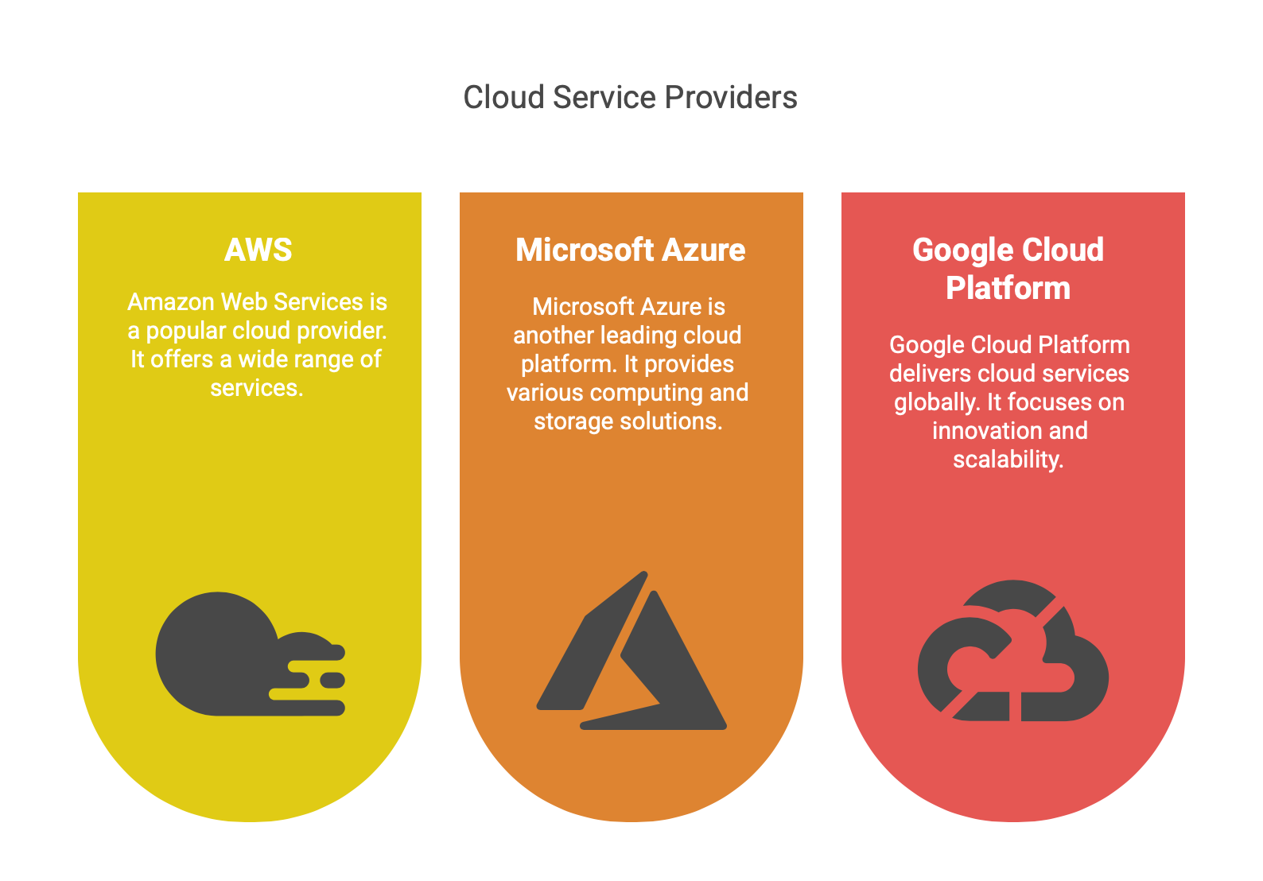
Cloud Deployment Models
These define how cloud services are made available to users. There are three main types:
1. Public Cloud
Services are provided over the public internet.
Anyone can use them—individuals or organizations.
Managed by third-party providers like:
Amazon Web Services (AWS)
Microsoft Azure
Google Cloud Platform (GCP)
Example: Hosting a website on AWS that anyone can visit.
.

Slide 10
Cloud Deployment Models
2. Private Cloud
Used by a single organization only.
Can be hosted on-premises or by a third party.
Offers greater control and security.
Best for organizations with strict regulatory or data privacy needs.
Example: A bank using a private cloud to store customer data securely
3.Hybrid Cloud
Combination of public and private clouds.
Allows data and applications to move between the two environments.
Offers flexibility:
Keep sensitive data in the private cloud
Use the public cloud for less sensitive tasks or to handle peak loads
Example: A company runs payroll apps in a private cloud but uses public cloud resources to process reports during tax season.
.

Slide 11
Benefits of Cloud Computing
Cost Efficiency – Cloud computing reduces the capital expense of buying hardware and software. You pay only for the services you use (pay-as-you-go), making it economical, especially for startups and small businesses.
Scalability – It allows businesses to scale resources up or down as needed. Whether you're running a small website or a large e-commerce platform, cloud services adjust to your demands instantly.
Flexibility and Mobility – Users can access data and applications from anywhere with internet access. This supports remote work, real-time collaboration, and increased productivity.
Disaster Recovery – Cloud providers typically offer built-in backup and disaster recovery solutions, reducing downtime and data loss in case of unexpected failures.
Security and Compliance Options – Most cloud platforms offer robust security features such as encryption, identity access management, and compliance certifications (e.g., HIPAA, GDPR).
.

Slide 12
Why Use Cloud Computing?
Benefits:
Cost Efficiency: No upfront hardware costs.
Scalability: Instantly handle traffic spikes (e.g., Black Friday sales).
Reliability: 99.9% uptime SLAs.
Global Reach: Deploy in multiple regions (e.g., AWS’s 25+ geographic regions).
Challenges:
Security concerns (shared responsibility model).
Vendor lock-in.
Latency for real-time applications.
Case Study:
How Airbnb scaled using AWS: Migrated from physical servers to cloud for global scalability.
.

Slide 13
Major Cloud Providers Details
.
Provider | Market Share | Key Services
AWS | 33% | EC2, S3, Lambda
Azure | 22% | Virtual Machines, Azure Functions
Google Cloud | 9% | Compute Engine, BigQuery

Slide 14
Real-World Use Cases
Hosting Websites and Apps: Platforms like AWS and Azure host millions of web applications for scalability and availability.
Data Storage and Backup: Services like Google Drive, Dropbox, or AWS S3 provide safe, scalable cloud storage.
Big Data Analytics: Companies use cloud tools (e.g., Google BigQuery, AWS Redshift) to analyze vast amounts of data efficiently.
AI and Machine Learning Deployment: Cloud platforms enable training, deployment, and scaling of ML models (e.g., Google Vertex AI, Azure ML).
Content Delivery: Streaming platforms like Netflix and YouTube use Content Delivery Networks (CDNs) in the cloud to deliver content smoothly to global users.
.

Slide 15
Summary:
Cloud computing delivers computing services (e.g., storage, servers, software) over the internet to enable scalability, flexibility, and cost-efficiency.
It features on-demand self-service, broad network access, resource pooling, rapid elasticity, and measured service.
Service models include:
IaaS (Infrastructure as a Service): Offers virtual machines and storage (e.g., AWS EC2).
PaaS (Platform as a Service): Provides development tools and frameworks (e.g., Heroku).
SaaS (Software as a Service): Delivers software via web browsers (e.g., Google Workspace).
Deployment models are:
Public cloud (shared across multiple users),
Private cloud (exclusive to one organization),
Hybrid cloud (mix of public and private).
Benefits include cost savings, ease of scalability, remote access, disaster recovery, and strong security options.
Common use cases include hosting websites, storing and analyzing big data, deploying AI/ML models, and streaming content.

Slide 16
Resources & Further Reading
Cloud Computing: Concepts, Technology & Architecture by Thomas Erl
A foundational book explaining core cloud concepts, service models, and architectures.
Cloud Computing: Principles and Paradigms by Rajkumar Buyya et al.
Covers academic and practical perspectives on cloud deployment models, services, and research trends.
AWS, Azure & Google Cloud Official Documentation
Authoritative, real-world references for learning IaaS, PaaS, SaaS implementations.
AWS | Azure | GCP
Architecting the Cloud by Michael J. Kavis
A hands-on guide for IT professionals designing and deploying scalable cloud architectures.

Slide 17
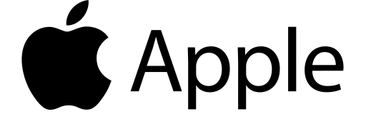

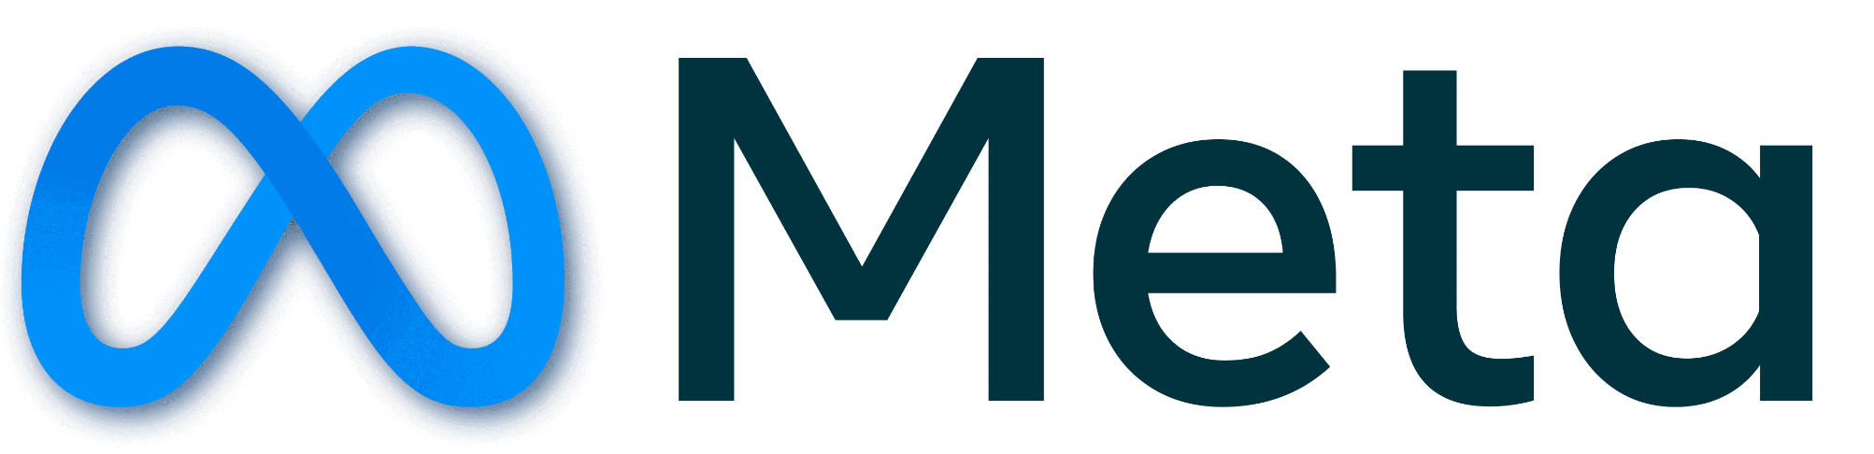





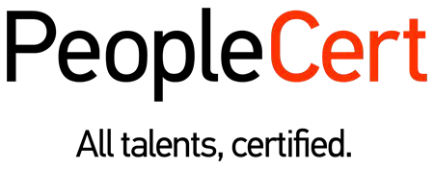








الشراكات العالمية

Slide 18
شــــــكــــرًا لكــــــم
THANK YOU

